Slide 1
Test-Driven Development(TDD)
Mohammad Ali Olama

Slide 2

Software testing
Software testing involves executing a program to identify any error or bug in the software product’s code. This process takes into accounts all aspects of the software, including its reliability, scalability, portability, reusability, and usability.
The main goal of software testing is to ensure that the system and its components meet the specified requirements and work accurately in every case.

Slide 3
What have we been doing so far ?
We have been writing source codes before writing tests for them!
This approach is called Test-Later Development (TLD)
Is there any benefit? Yes!
The development process goes on much faster!
Writing source codes is easy. (if you know what you need!)
Less trivial test will be added to the suitcase.
Is there any drawback? Yes!
Many bugs will be found later and need to be fix! Doubles the time working on source code!
If you don’t have a precise roadmap of the feature you are working on, you may miss some small details which may be found later.

Slide 4

What are we going to do ?!

Slide 5
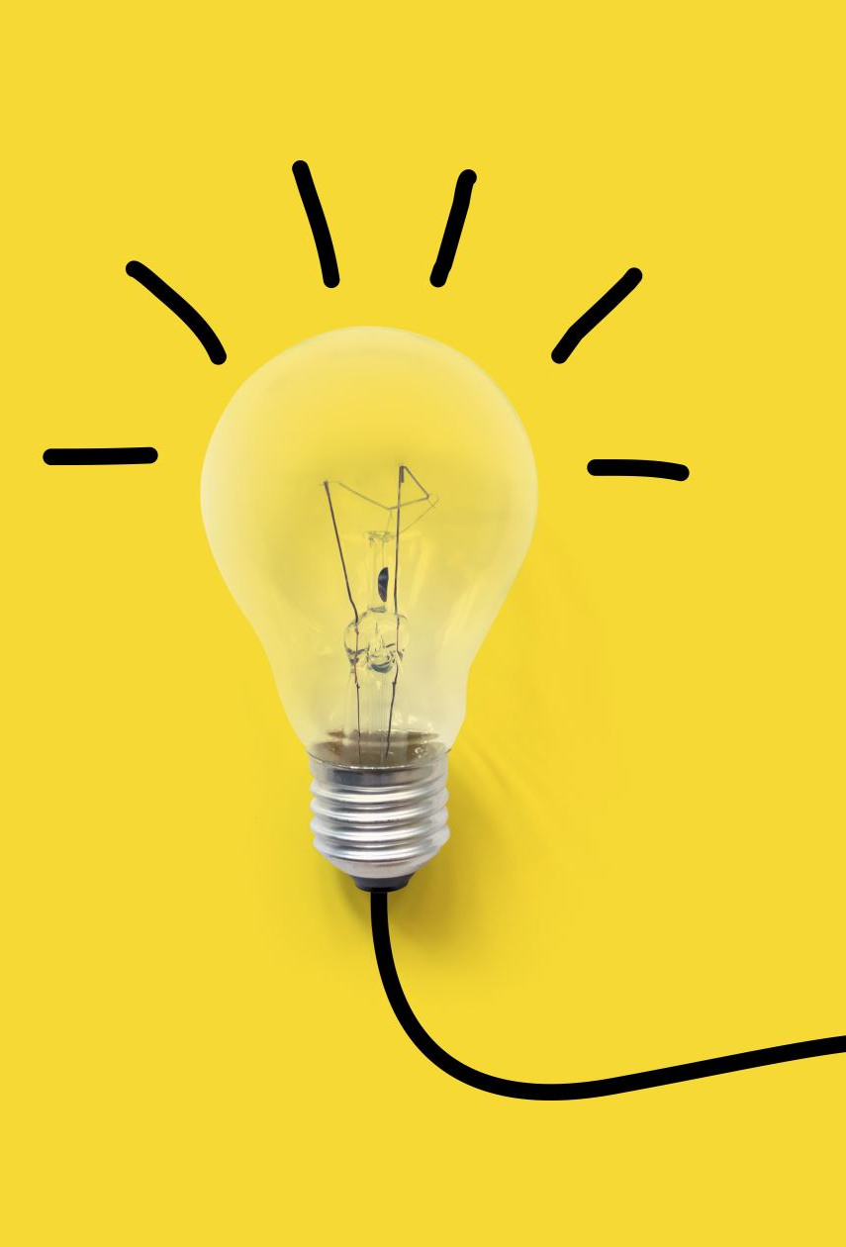
Test-Driven Development(TDD)
Test Driven Development (TDD) is a software development practice that focuses on creating unit test cases before developing the actual code. It is an iterative approach combining programming, unit test creation, and refactoring.

Slide 6

The diagram of TDD
Add a test
Run and watch tests fail.
Write code & Implement
Run tests
Refactor / Organize

Slide 7





The diagram of TDD
Add a test
Refactor / Organize
Run and watch tests fail.
Run tests
Write code & Implement.
(as simple as possible)

Slide 8



State the problem you are going to solve/ the feature you are going to add.
make a to-do list. this list will remind us what we need to do, to keep us focused, and to tell us when we are finished. When we start working on an item, we’ll make it bold, like this. When we finish an item, we’ll cross it off, like this. When we think of another test to write, we’ll add it to the list. Initialize the list with some primary tasks.
Pick one task and write tests for it(according to the routine described in previous slide). When finished, cross it off from the list. If necessary, add more tasks to the list.

Slide 9

An example of TDD.
Fizz-Buzz game =)

Slide 10

Definition
It’s a simple game. we are a given a positive integer:
If it is divisible by 3 , Print “FIZZ”
If it is divisible by 5 , Print “BUZZ”
If it is divisible by both Print “FIZZ-BUZZ”
Otherwise print the number itself!
Now let’s write some codes!

Slide 11
The Calculator Problem
State the problem:
Suppose we are going to build a calculator Api.(Simple, huh?)
Create To-do List:
We need some basic functions:
Addition
Pick a task and start.
For the sake of a good example, let’s pick division first!
Addition
Subtraction
Division
Multiplication
Subtraction
Division
Multiplication

Slide 12
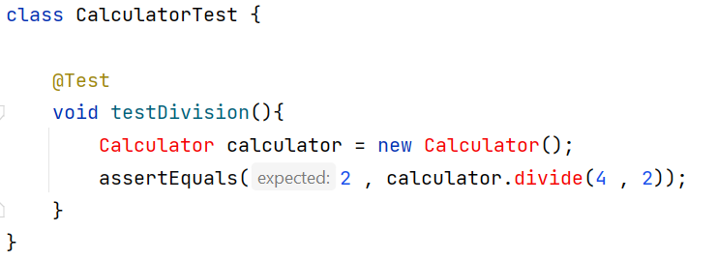
Let’s create a test class and write a simple division test. We expect the result of calculator.divide(4 , 2) to be (4 / 2 = 2)
Add a test

Slide 13
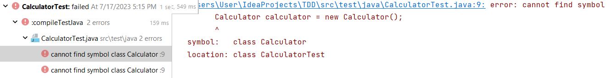
Let’s run the code now.
Oops! We have compile error! (we didn’t know that!). So the test fails.
Run and watch tests fail.

Slide 14
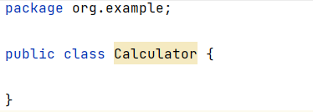
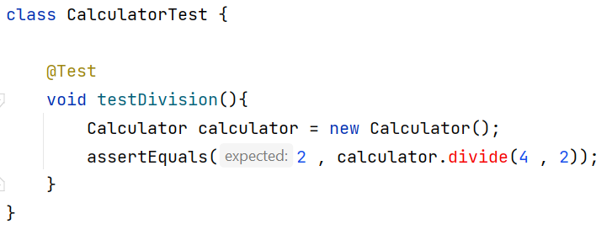
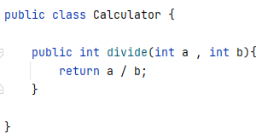
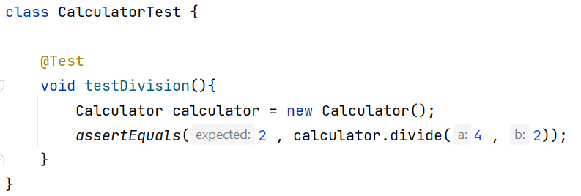
First let’s create a Calculator class.
And check we move a step forward =)
This step should also be broken into several tiny steps of writing tests and refactoring!
Now let’s create ‘divide’ method:
We are done!
Write code & Implement

Slide 15
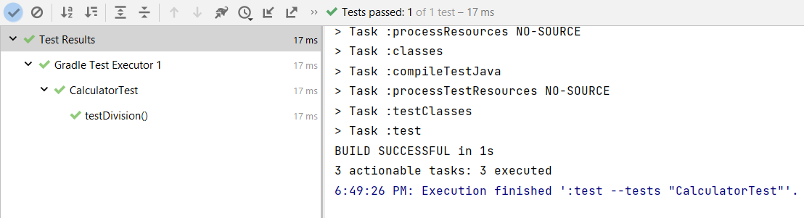
The tests will pass =)))
Run tests

Slide 16
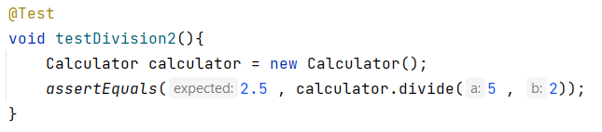
Let’s create another test and write a simple division test. We expect the result of calculator.divide(5 , 2) to be (5/ 2 = 2.5)
Add a test

Slide 17
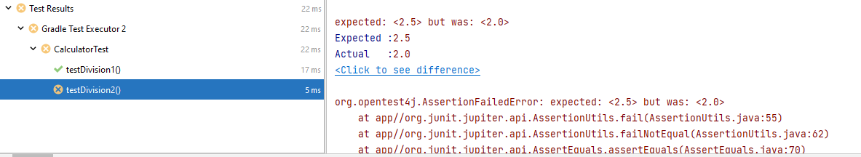
Let’s run the code now.
Oops! We have wrong answer error! (we didn’t know that!). So the test fails.
Run and watch tests fail.

Slide 18
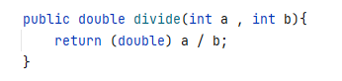
We change return value type of ‘divide’ method and also cast 1 of the
Write code & Implement

Slide 19
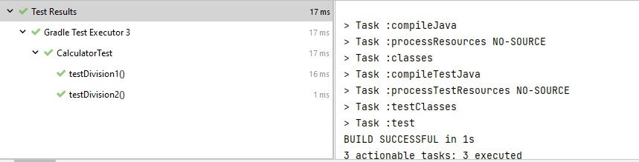
The tests will pass =)))
Run tests

Slide 20
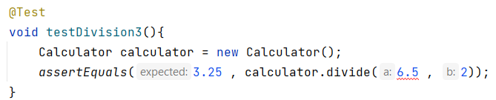
Let’s create another test and write a simple division test. We expect the result of calculator.divide (6.5 , 2) to be (6.5 / 2 = 3.25)
Add a test

Slide 21
The code has compile error and won’t run.
Run and watch tests fail.

Slide 22
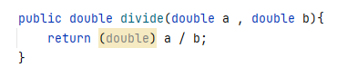
We change return value type of ‘divide’ method and also cast 1 of the
Write code & Implement

Slide 23
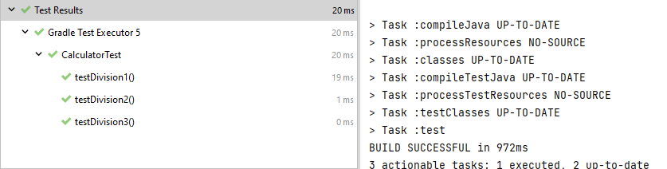
The tests will pass =)))
Run tests

Slide 24
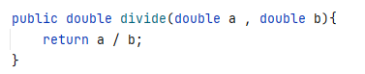
The (double) cast in divide method is redundant. So we remove it.
Refactor / Organize

Slide 25
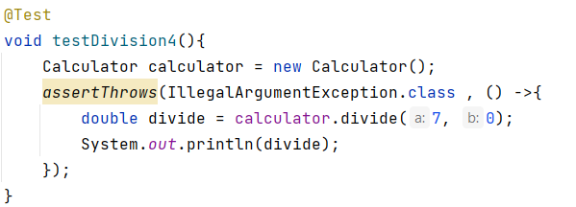
Let’s create another test and write a simple division test. We expect the result of calculator.divide (7 , 0) to be ‘IllegalArgumentException’
Add a test

Slide 26
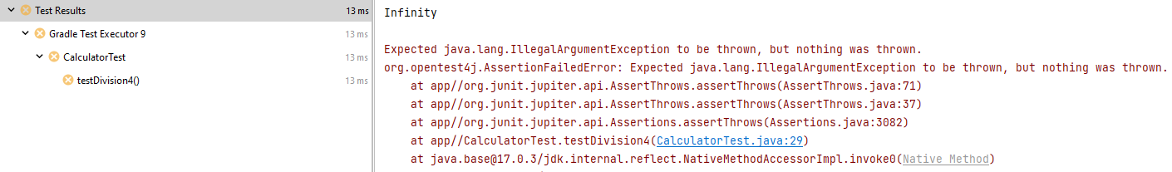
The test will fail:
We were expecting to receive an exception, but nothing was thrown.(This is because of the implementation of division for doubles in java which will return infinity when divisor = 0.0. But the result of division for ints will throw ‘ArithmeticException’ when divisor = 0. )
Run and watch tests fail.

Slide 27
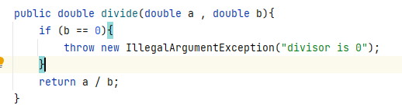
We add an if clause to the body of division method :
(P.S: note that it is not a good idea to compare floating point numbers like doubles with == or even .equal() method. This is due to the way a computer save a floating point number.)
Write code & Implement

Slide 28
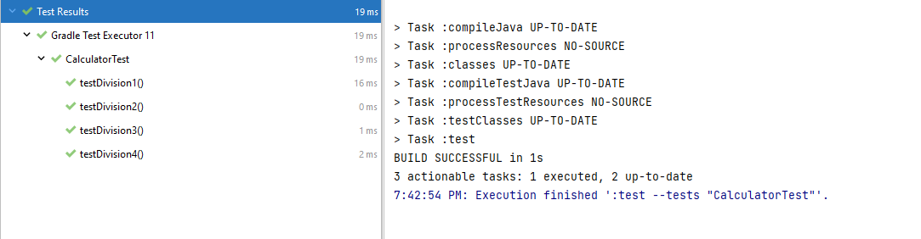
The tests will pass =)))
Run tests

Slide 29
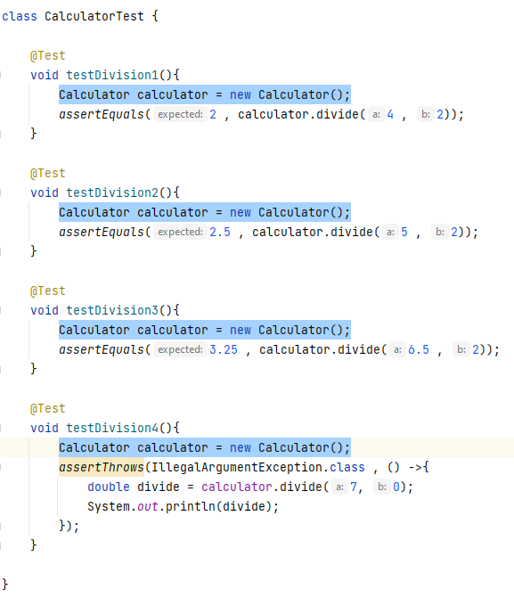
Currently, our CalculatorTest class looks like this :
We have 4 lines of code duplicate which we can eliminate simply =)
Refactor / Organize

Slide 30
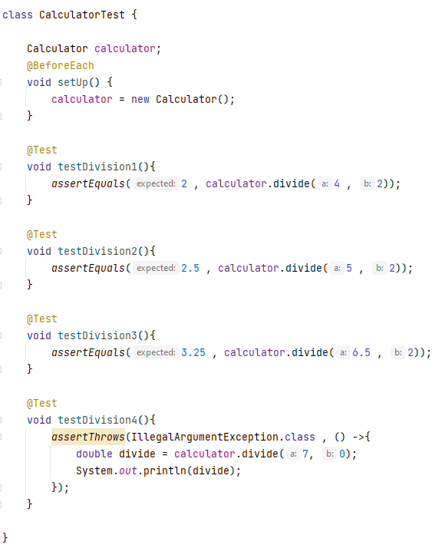
Note that in this example we can use “@BeforeAll” instead of “@BeforeEach” .
Refactor / Organize

Slide 31
TDD benefits
Better Design
Tests serve as documentation
Faster debugging
Cleaner code(because of refactoring)
Better code coverage
Most often, the failing code/test is in the most recently changed code.
Instant feedback on new code
Increased quality

Slide 32

TDD limitations
Counterproductive and hard to learn
Difficult in some situations:
GUI, Database, Web Service
Difficult to write test cases for hard-to-test code
Requires a higher level of experience from programmers
TDD blurs distinct phases of software development
design, code and test

Slide 33





TDD vs TLD
Developing Time:
TLD
Maintenance cost:
TDD
Code simplicity:
TLD
Productivity:
TLD
Code change:
TDD
In TDD you must refactor your codes regularly which makes your code more complex.
TDD makes sure that changes don’t impact the product, while test cases prevent unwanted changes
Notes:
Time: TLD development time is relatively lower than TDD because of the iterative nature of this last (between testing, coding, refactoring, and sheer learning curve). TLD is better focusing-wise than TDD where the whole focus will go on the code, and later on to automated tests. While in TDD constantly move to and from code and test cases which may decrease the focus
Learning Curve: TLD is simpler than TDD to be learned whereas the last one forces the developer to think about test cases, understand completely the requirements, choose the right design patterns, and do abstractions
Maintenance cost and Productivity: TDD is better in decreasing maintenance cost than TLD which increases productivity (Ratio between the functional value of software produced to the labor and expense)
Code size: The inclusion of many more test cases in TDD increases the size of code compared to TLD
Code simplicity: TLD codes are simpler than TDD. TLD mostly has Linear codes that are easier to understand. In contrast, TDD is relatively complex. Complexity is mainly due to the use of various design principles like interface, design pattern, Mock, etc.
Code change: TDD makes sure that changes don’t impact the product, while test cases prevent unwanted changes

Slide 34

Acceptance TDD(ATTD)
Our customers want software that helps them to be more productive, make more money, maintain or improve operational capability, take over a market, and so forth. This is what we need to deliver with our software—functionality to support business function or market needs.
Acceptance test-driven development (acceptance TDD) is what helps developers build high-quality software that fulfills the business’s needs as reliably as TDD helps ensure the software’s technical quality.
Acceptance TDD helps coordinate software projects in a way that helps us deliver exactly what the customer wants when they want it, and that doesn’t let us implement the required functionality only half-way or overkill the client’s required functionality.

Slide 35
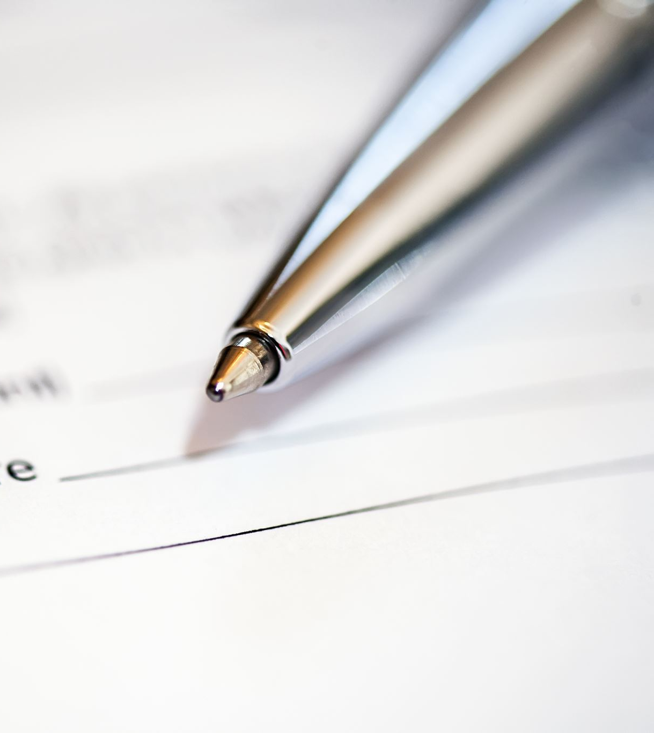
User Story …
User stories are an extremely simple way to express requirements. In its classic form, a user story is a short sentence stating who does what and why.
The story is not intended to document the requirement. The story is intended to represent the requirement, acting as a promise of a future conversation between the customer and the developer.
It is something like this:
“ As a [role/actor/stakeholder] ”
“ I want a [feature/capability] ”
“ So That a [benefit] “

Slide 36

Properties of acceptance tests:
Owned by the customer
Written together with the customer, developer, and tester
About the what and not the how
Expressed in the language of the problem domain
Concise, precise, and unambiguous

Slide 37
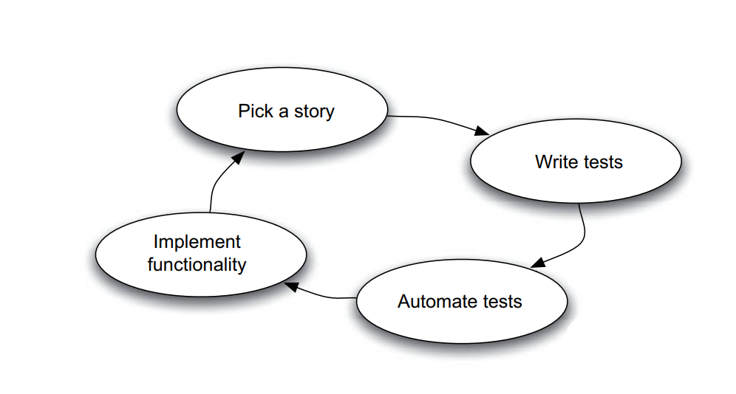

Slide 38
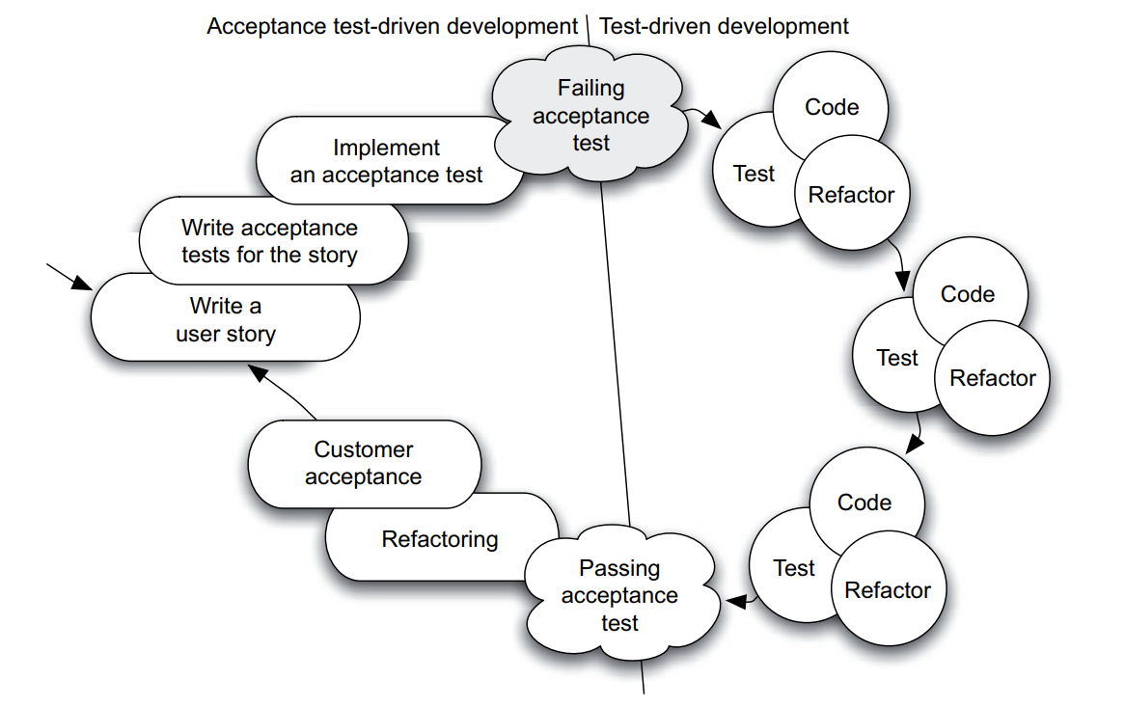

Slide 39
Ok, now what is BDD ?
BDD stands for Behavior-Driven Development.
BDD typically involves the software developers, test engineers, and project managers as well as other stakeholders.
Using a Domain-Specific Language(DSL), these examples are then described and put into a feature file.
A domain-specific language (DSL) is a computer language specialized to a particular application domain. Like HTML for web pages, Matlab for matrix programming, SQL for relational database, etc.
This feature file is subsequently converted into a specification that can be executed, thereby allowing developers to write actual tests that can also be executed.

Slide 40

HOW ?
2 parts :
1. User story :
“ As a [role/actor/stakeholder] ”
“ I want a [feature/capability] ”
“ So That a [benefit] “
2. Acceptance criteria(Scenario):
“ Given [initial context] ”
“ when [event occurs] “
“ Then [ensure some outcomes] “

Slide 41


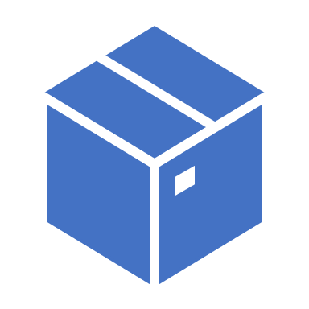
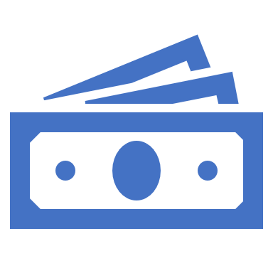
Example: Market
Scenario 1: Items returned for refund should be added to inventory.
Given that a customer previously bought a black sweater from me
And I have three black sweaters in inventory,
When they return the black sweater for a refund,
Then I should have four black sweaters in inventory.
Scenario 2: Exchanged items should be returned to inventory.
Given that a customer previously bought a blue garment from me
And I have two blue garments in inventory
And three black garments in inventory,
When they exchange the blue garment for a black garment,
Then I should have three blue garments in inventory
And two black garments in inventory.
Title: Returns and exchanges go to inventory.
As a store owner,
I want to add items back to inventory when they are returned or exchanged,
so that I can sell them again.

Slide 42



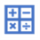
Calculator, Again!
Title: Returns and exchanges go to inventory.
Scenario 1: Integer / Integer is Double.
Given that I have developed a calculator
When I pass 5 and 2,
Then I should get “2.5”.
Scenario 2: : Double / zero is Exception.
Given that I have developed a calculator
When I pass 7 and 0,
Then I should get “ERROR”.
As a store owner,
I want to add items back to inventory when they are returned or exchanged,
so that I can sell them again.

Slide 43
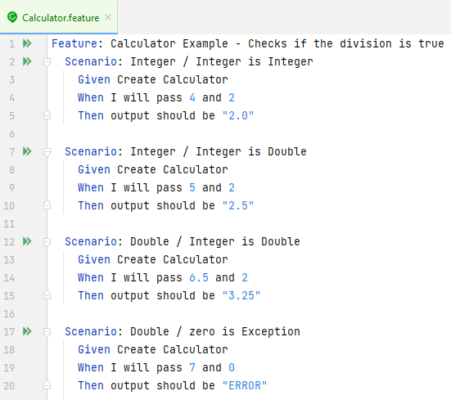
Java Implementation Using Cucumber
cucumber.io

Slide 44
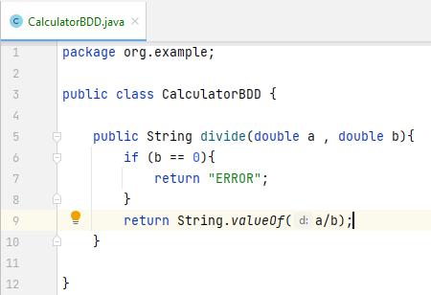
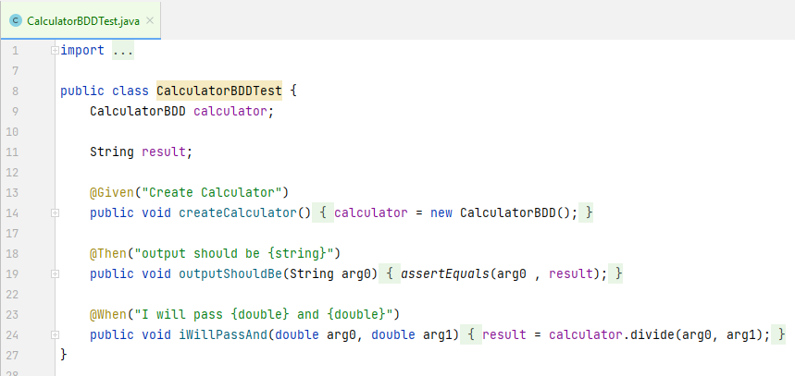
Java Implementation Using Cucumber
cucumber.io

Slide 45
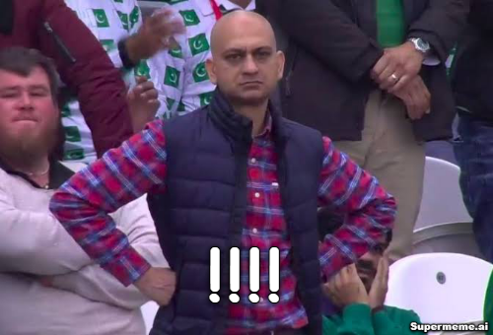

Slide 46
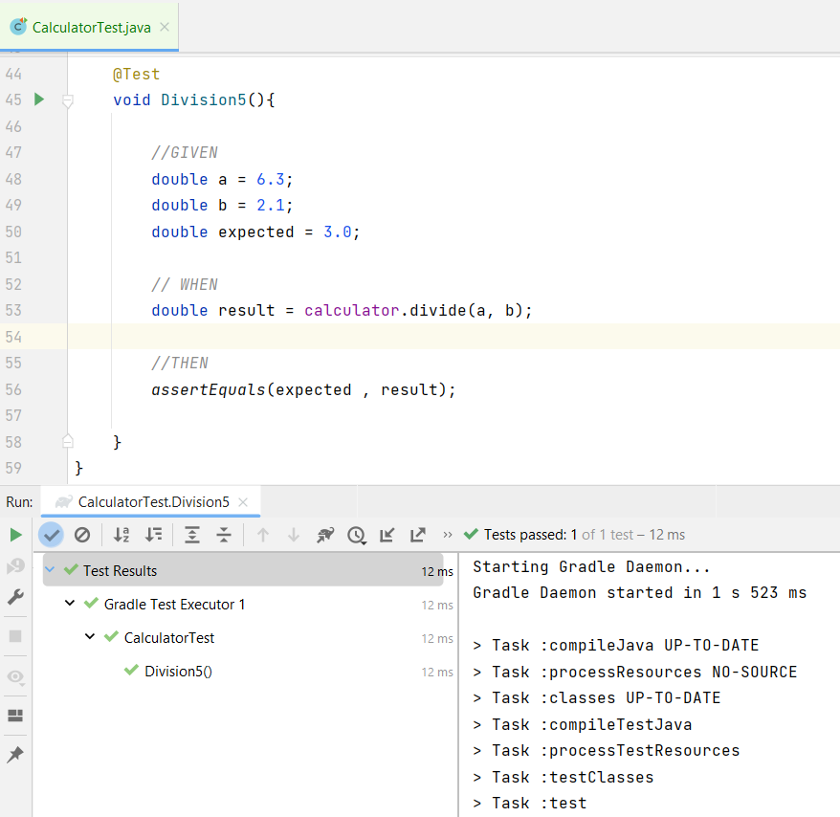
We don’t have to write all these stuff for BDD. Just write a code inspired by BDD.

Slide 47
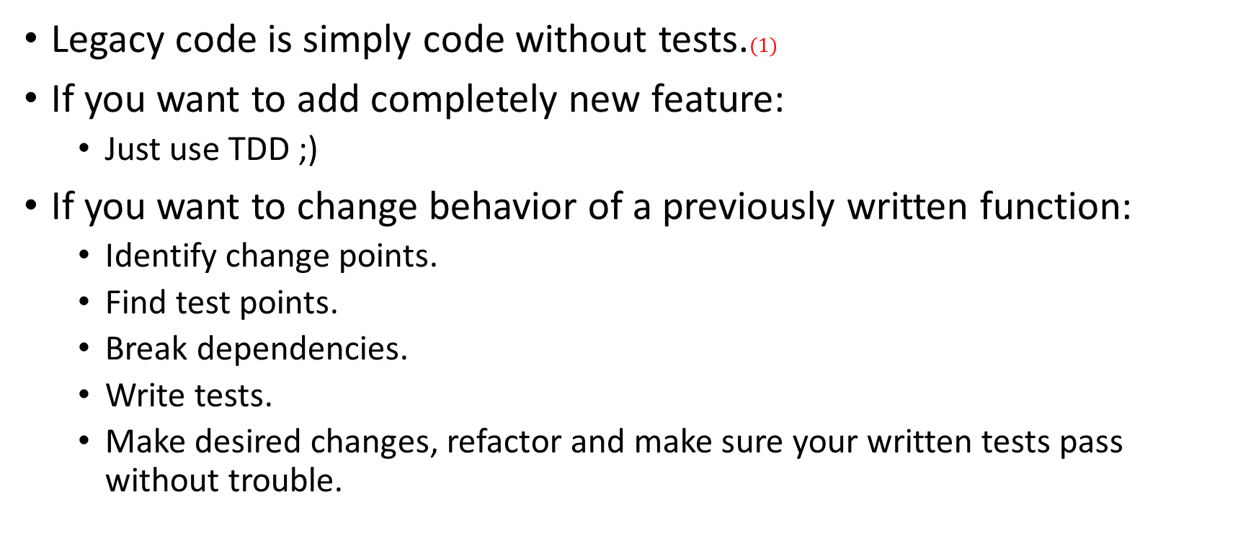
Tips for Legacy code.
Legacy code is simply code without tests.$(1)$
If you want to add completely new feature:
Just use TDD ;)
If you want to change behavior of a previously written function:
Identify change points.
Find test points.
Break dependencies.
Write tests.
Make desired changes, refactor and make sure your written tests pass without trouble.
(1): Working Effectively with Legacy Code, Michael C. Feathers

Slide 48


